Slide 1
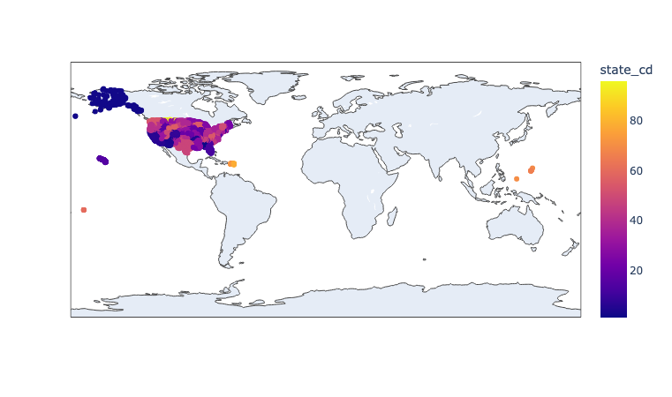
All recording stations

Slide 2
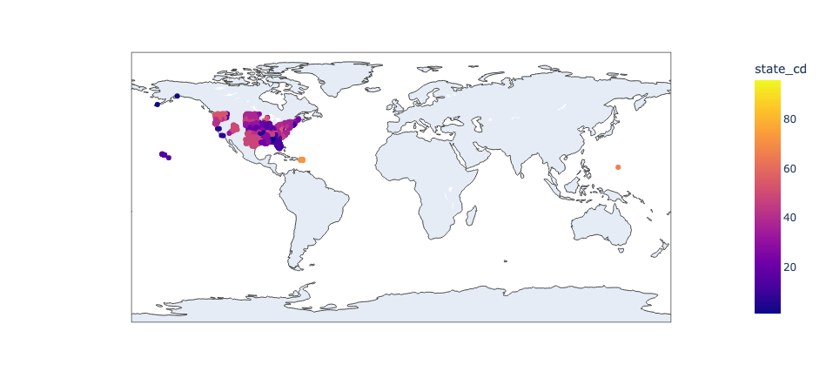
All water height recording stations

Slide 3
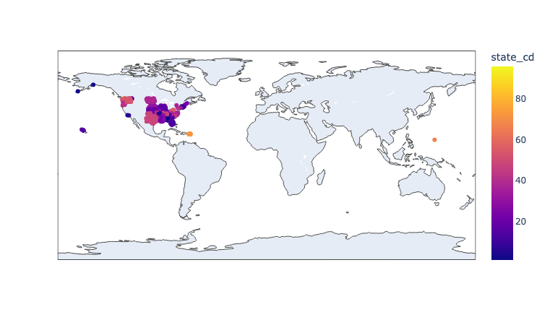
Good water height recording stations
Poor recording stations

Slide 4
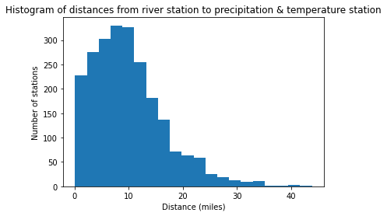
Accuracy of precipitation and temperature data

